Slide 1
UNIT-III
Greedy Approach
Prepared by Dr. N. Subhash Chandra
From Web resources, Computer Algorithms , Horowitz Sahni

Slide 2
MINIMUM SPANNING TREE
A spanning tree is a subset of Graph G, which has all the vertices covered with minimum possible number of edges.
Hence, a spanning tree does not have cycles and it cannot be disconnected.
Note 1: Every connected and undirected Graph G has at least one spanning tree.
Note 2: A disconnected graph does not have any spanning tree.
A complete undirected graph can have maximum n^{n-2} number of spanning trees, where n is the number of nodes.

Slide 3
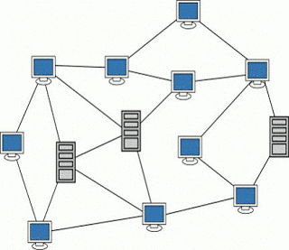
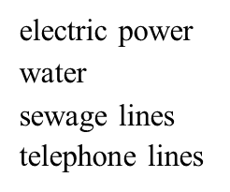
Real world scenario of Spanning tree-Computer networks
It can be used to determine the least costly paths with no cycles in this network, thereby connecting all the computers at a minimum cost.

Slide 4
Spanning trees
Spanning Tree: Spanning tree is a non-cyclic sub-graph of a connected and undirected graph G that connects all the vertices together. A graph G can have multiple spanning trees.
Connected: every node is reachable from every other node. Undirected: edges do not have an associated direction
A Spanning tree for a graph has no cycles but still connects to every house.
If G is a connected graph with n vertices and m edges, spanning tree of G must have n-1 edges, and no. of edges deleted from G to get a spanning tree must be m-(n-1)=m-n+1.
A Graph may have many spanning trees; for instance the complete graph on
four vertices.
A connected, undirected graph
Four of the spanning trees of the graph

Slide 5
Finding a spanning tree
To find a spanning tree of a graph,
An undirected graph
One possible result of a BFS starting from top
One possible result of a DFS starting from top
4

Slide 6
Minimum-cost spanning trees
Minimum Spanning Tree: There can be weights assigned to every edge in a weighted graph. However, A minimum spanning tree is a spanning tree which has minimal total weight among all spanning trees.
Suppose you have a connected undirected graph with a weight (or cost) associated with each edge
The cost or weight of a spanning tree would be the sum of the costs of its edges.
A minimum-cost spanning tree is a spanning tree of a connected undirected graph that has the lowest cost.
If there are n vertices in the graph , then each spanning tree has n vertices & n- 1 edges.
_{A} 16 _{B A} 16 _{B}
6 6
21 11 11
19
5
14
5
F
C
10
F C
33
_{E} 18 _{D}
_{E} 18 _{D}
A minimum-cost spanning tree
A connected, undirected graph

Slide 7
Finding minimum spanning trees
There are two basic algorithms for finding minimum-cost spanning trees, and both are greedy algorithms i.e., these always processes the edge with the least weight or cost.
To apply these algorithms, the given graph must be weighted, connected and undirected.
Kruskal’s algorithm
Prim’s algorithm:

Slide 8
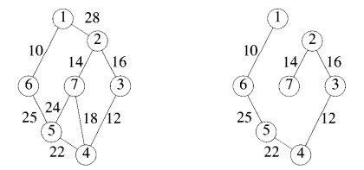
i. Kruskal’s Algorithm
Step 1 - Remove all loops and Parallel Edges.
Step 2 - Arrange all edges in their increasing order of weight.
Step 3 - Add the edge which has the least weightage iff it does not form cycle.
Ex:

Slide 9
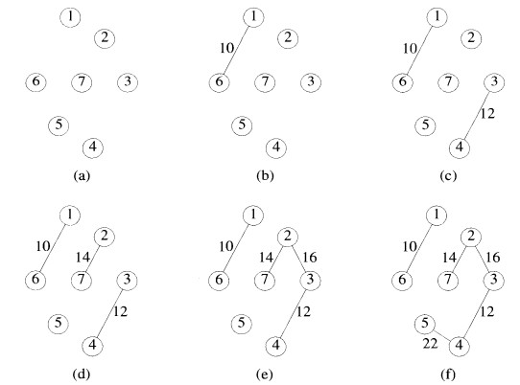

Slide 10
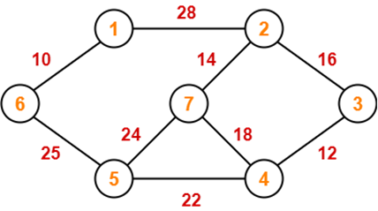

Slide 11
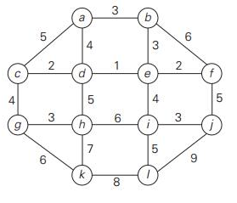
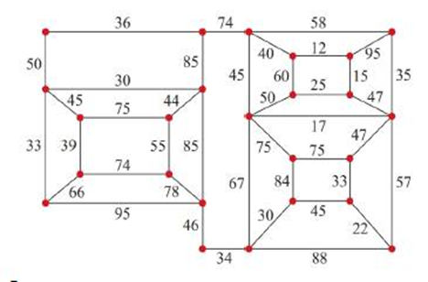
Kruskal’s Method-Problem 2
8
10
14
1
3
5
7
1
3
5
7
7
4
12
6
3
2
2
4
6
8
2
4
6
8
9

Slide 12
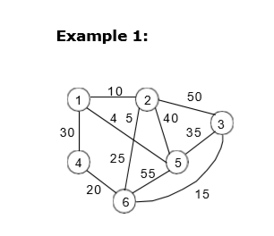
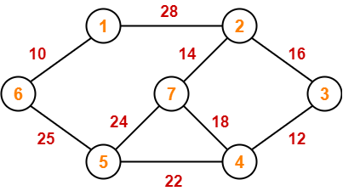
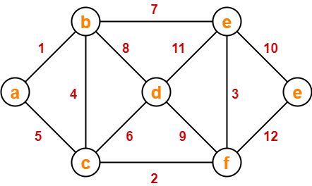
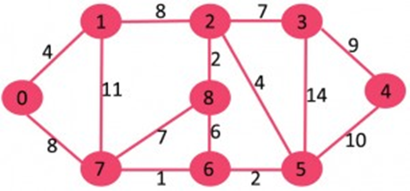

Slide 13
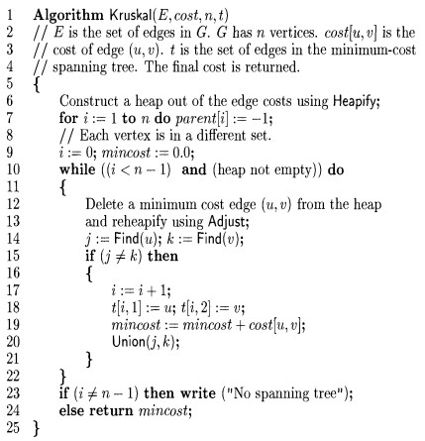
Kruskal’s Algorithm

Slide 14
Time Complexity:
O(ElogE) or O(ElogV).
Sorting of edges takes O(ELogE) time.
After sorting, we iterate through all edges and apply find-union algorithm.
The find and union operations can take atmost O(LogV) time.
So, overall complexity is O(ELogE + ELogV) time. The value of E can be atmost O(V2), so O(LogV) are O(LogE) same. Therefore, overall time complexity is O(ElogE) or O(ElogV)
Worst case time complexity: Θ(E log V) using Union find
Average case time complexity: Θ(E log V) using Union find
Best case time complexity: Θ(E log V) using Union find
Space complexity: Θ(E + V)

Slide 15

ii. Prim’s Algorithm
Prim's algorithm, in contrast with Kruskal's algorithm, treats the nodes as a single tree and keeps on adding new nodes to the spanning tree from the given graph.
Step 1 - Remove all loops and parallel edges.
Step 2 - Choose any arbitrary node as root node.
Step 3 - Check outgoing edges and select the one with less cost.

Slide 16
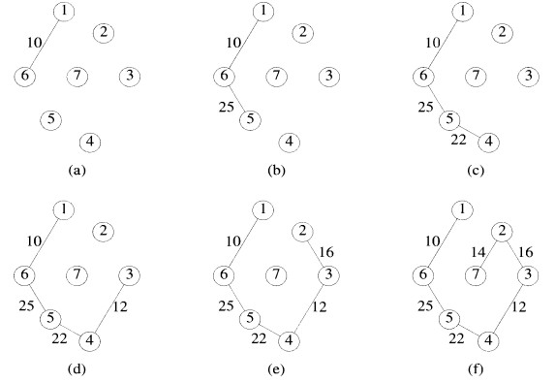

Slide 17
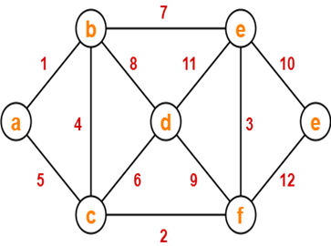

Slide 18
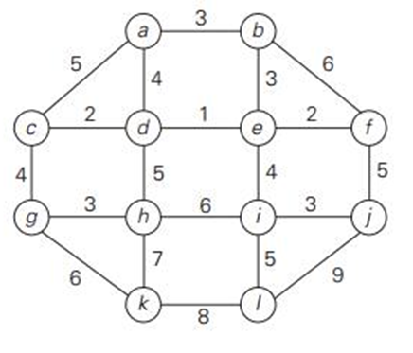
Example: Prim’s Method
8
10
14
1
3
5
7
7
4
12
6
3
2
2
4
6
8
9

Slide 19

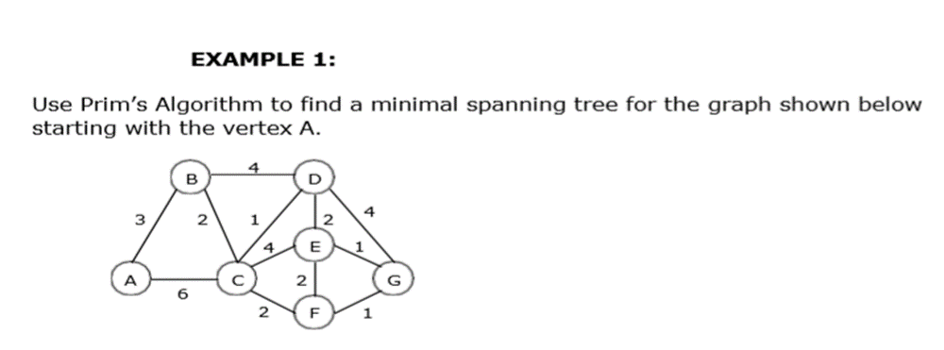

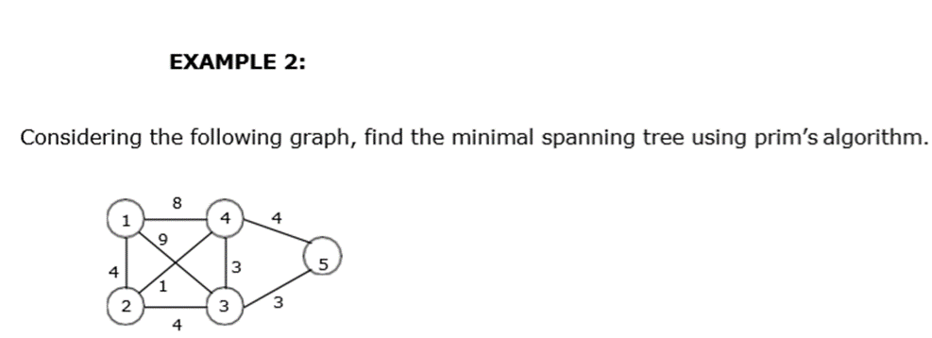
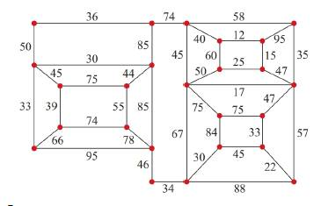

Slide 20
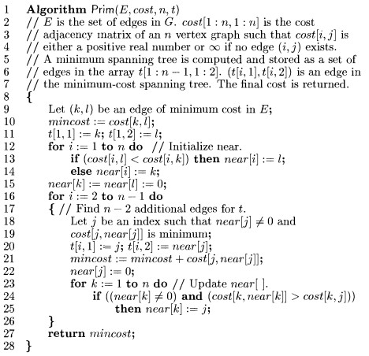
Prim’s Algorithm

Slide 21
Time Complexity Analysis
If adjacency list is used to represent the graph, then using breadth first search, all the vertices can be traversed in O(V + E) time.
We traverse all the vertices of graph using breadth first search and use a min heap for storing the vertices not yet included in the MST.
To get the minimum weight edge, we use min heap as a priority queue.
Min heap operations like extracting minimum element and decreasing key value takes O(logV) time.
So, overall time complexity
= O(E + V) x O(logV)
= O((E + V)logV)
= O(ElogV)
This time complexity can be improved and reduced to O(E + VlogV) using Fibonacci heap.

Slide 22
Difference between Prim’s Algorithm and Kruskal’s Algorithm
Prim’s Algorithm | Kruskal’s Algorithm
The tree that we are making or growing always remains connected. | The tree that we are making or growing usually remains disconnected.
Prim’s Algorithm grows a solution from a random vertex by adding the next cheapest vertex to the existing tree. | Kruskal’s Algorithm grows a solution from the cheapest edge by adding the next cheapest edge to the existing tree / forest.
Prim’s Algorithm is faster for dense graphs. Worst case time complexity of Prim’s Algorithm is- O(ElogV) using binary heap O(E + VlogV) using Fibonacci heap Prim’s Algorithm is preferred when- There are large number of edges in the graph like E = O(V²). | Kruskal’s Algorithm is faster for sparse graphs. Worst case time complexity: Θ(E log V) Kruskal’s Algorithm is preferred when- There are less number of edges in the graph like E = O(V) The edges are already sorted or can be sorted in linear time.

Slide 23
Dense graph and Sparse Graph
Dense graph is a graph in which the number of edges is close to the maximal number of edges. Represents with Adjacency matrix.
Sparse graph is a graph in which the number of edges is close to the minimal number of edges. Represented with adjacency list

Slide 24
Single source shortest path(Dikstra’s)
For a given source node in the graph, the algorithm finds the shortest path between that node and every other. It also used for finding the shortest paths from a single node to a single destination node by stopping the algorithm once the shortest path to the destination node has been determined.
Graph is directed/undirected weighted connected graph. No negative weight edges
Applications:
Digital Mapping Services in Google Maps,
Social Networking Applications,
Telephone Network,
IP routing to find Open shortest Path First,
Flighting Agenda,
Designate file server, Robotic Path.

Slide 25
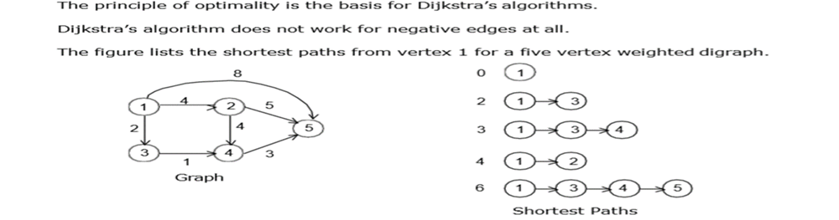
Concept with Example

Slide 26
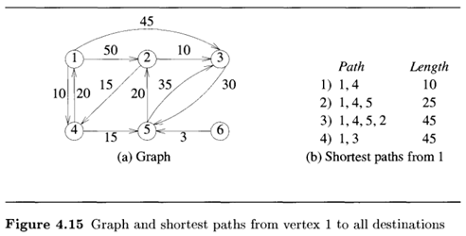
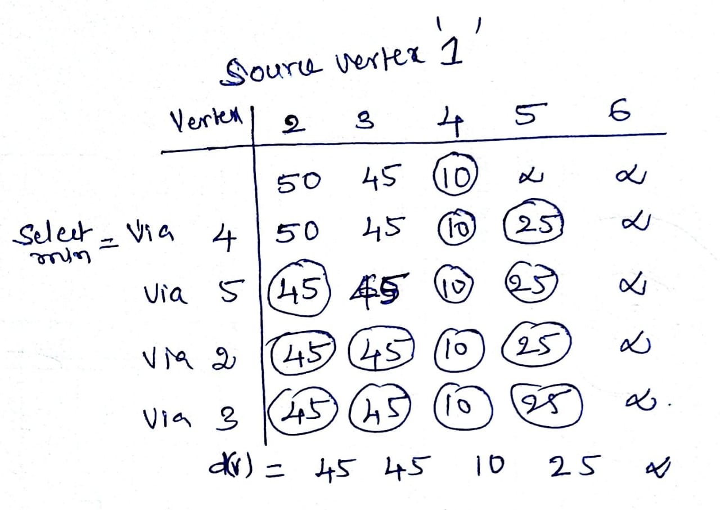
Example 1

Slide 27
Example 2
8
6
2
1
3
3
16
1
6
7
4
5
10
4
2
4
7
5
3
14

Slide 28
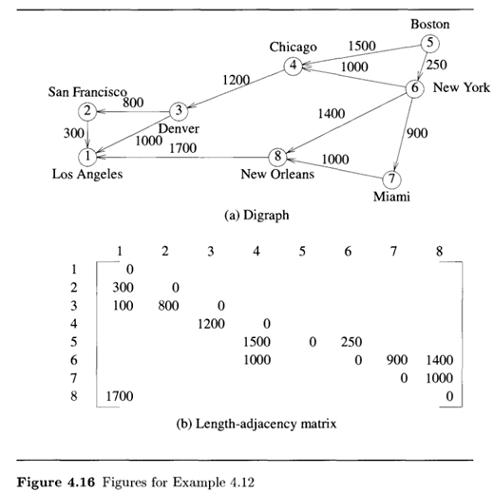
Example 3

Slide 29
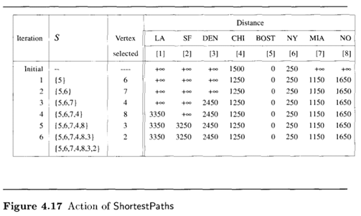
Problem 2

Slide 30
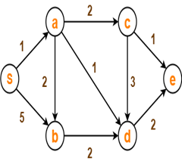
Problem 4

Slide 31
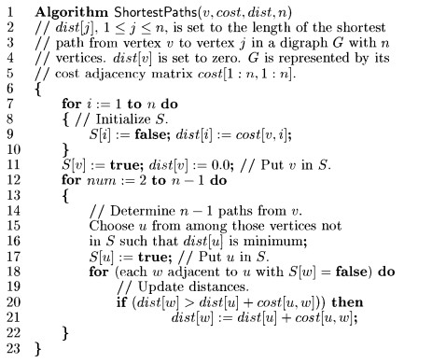
Dikstra’s Algorithm

Slide 32
Complexity
O(n) to select next destination vertex.
O(out-degree) to update d() and p() values when adjacency lists are used.
O(n) to update dist() and S() values when adjacency matrix is used.
Selection and update done once for each vertex to which a shortest path is found.
Total time is O(n² + e) = O(n²).
When a min heap of d() values is used in place of the linear list L of reachable vertices, total time is O((n+e) log n), because O(n) remove min operations and O(e) change key (d() value) operations are done.
When e is O(n²), using a min heap is worse than using a linear list.
When a Fibonacci heap is used, the total time is O(n log n + e).

Slide 33
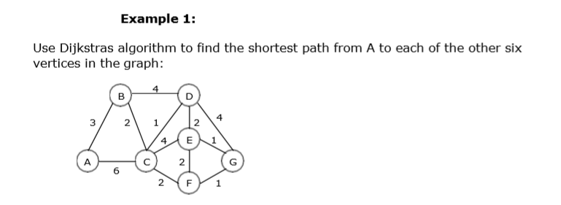
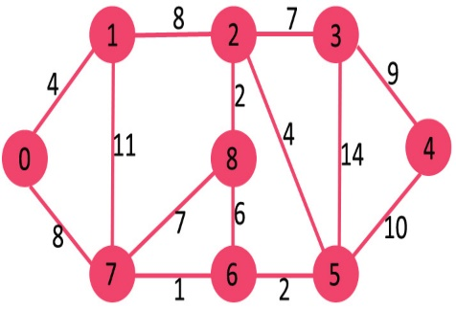
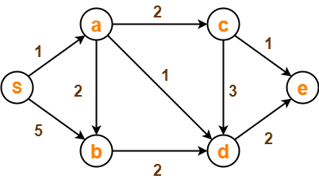
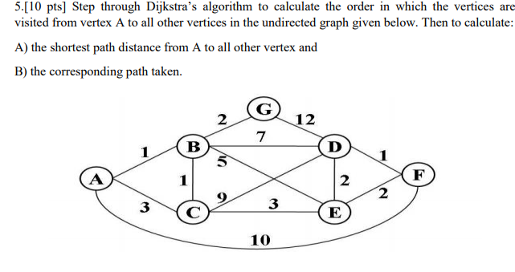
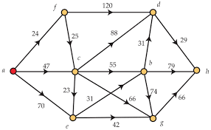
Shortest distance from 0
Shortest distance from S
Shortest distance from a
Shortest distance from a

